Slide 1
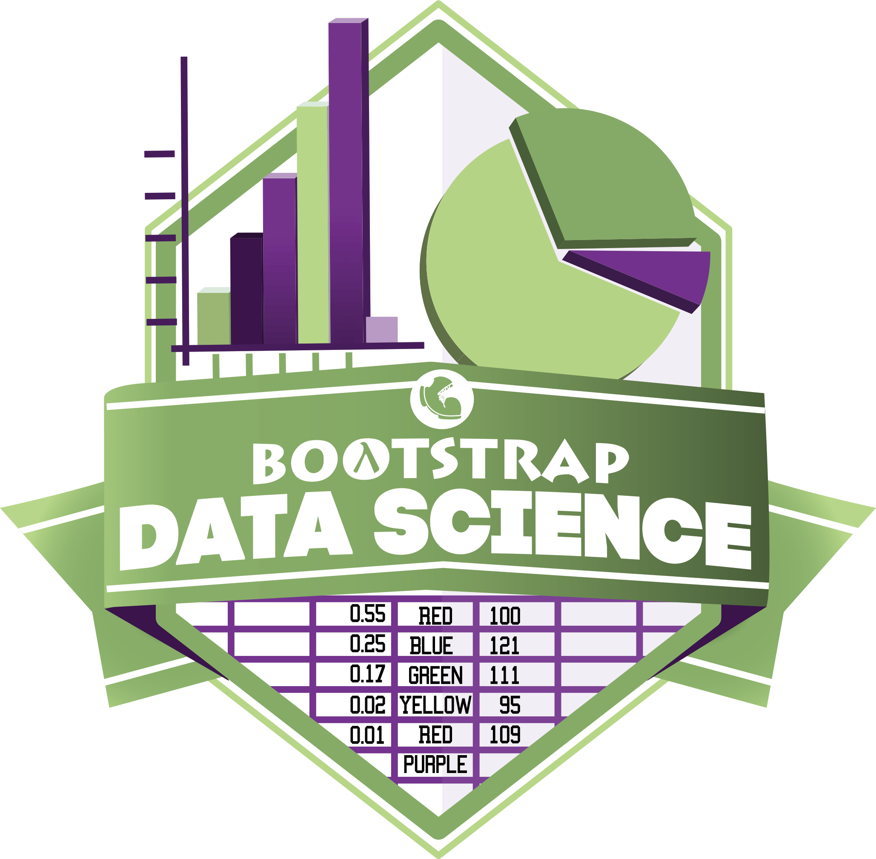
Notes:
Introduce Trainers, and have Participants introduce themselves

Slide 2


20 Thousand Students Annually
43% Girls and Young Women
46% African-American or Latino

Slide 3
What is Data Science?
Notes:
Equity implications of these points

Slide 4
Design Principles
Principle 1: It should be authentic¹
Keep data entry, analysis and visualization separate!
Analysis should be easily re-run on new/different data
Dynamic tables - not interconnected spreadsheets
Principle 2: It should be accessible
R?
Looping through 2D Arrays?
Link: https://www.jessesadler.com/post/excel-vs-r/
Notes:
Equity implications of these points

Slide 5
Authentic & Accessible
Build a DS tool made for learning!
Easy importing from Google Sheets
Make tables as easy as numbers
If tables are values, queries are expressions
You can teach a real DS course – with #NoLoops and #NoArrays!
Getting the tool right is necessary, but not sufficient
www.pyret.org
Notes:
Equity implications of these points

Slide 6
The Austerity Problem

Slide 7
The Austerity Problem
Austerity was based on recommendations from economists
Those economists created a giant Excel spreadsheet to analyze historical data
“Backed by millions of data points” sounds a lot more convincing than “backed by hundreds of data points”.
There was just one problem…
Notes:
Equity implications of these points

Slide 8
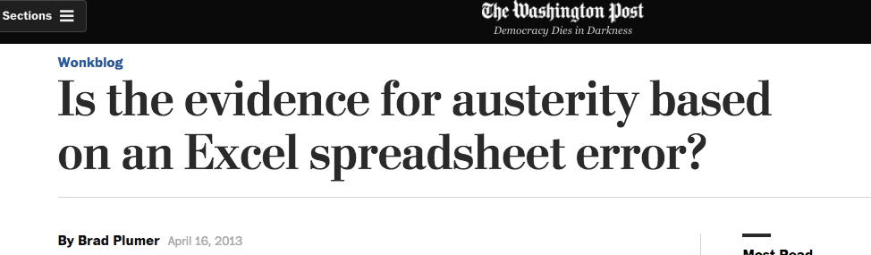
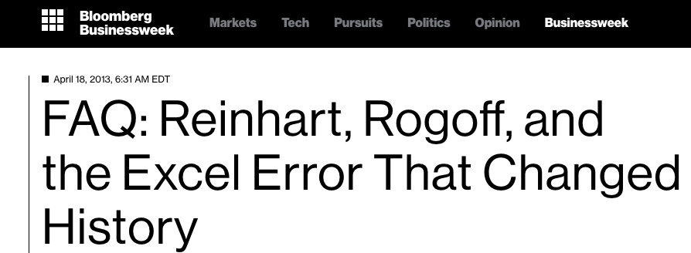
The Austerity Problem
Notes:
Equity implications of these points

Slide 9
The Austerity Problem
Data Science is not about writing for-loops, queries or Excel formulas…
…any more than programming is about “writing code”
Data Science is about analysis, and making sense of data. If all we do is teach kids Excel, R, etc…we fail.
Principle 3: Address the Austerity Problem
Notes:
If it’s more about programming than it is about thinking and writing, we fail

Slide 10
Goals for this Workshop
Understand what “Data Science” is, why it matters
Get comfortable with programming in Pyret
Work through the entire curriculum
Discuss pedagogy
Get your feedback

Slide 11
Bootstrap Materials
Software: In the cloud, or on your machine.
Lesson Plans: Detailed[*] curricula, student handouts, integrated workbooks, and supplemental activities.
Language: Algebraic semantics, integrated tables, integrated graphing and plotting

Slide 12
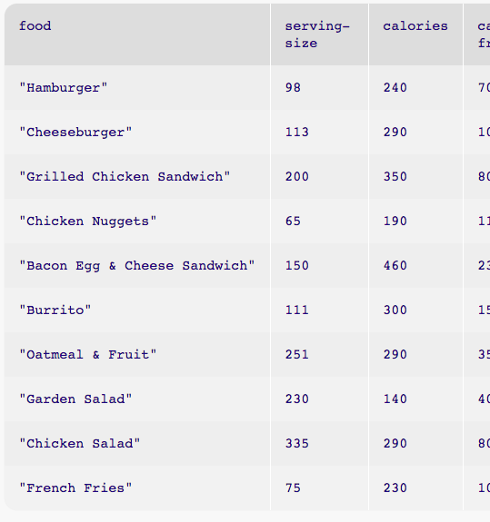
10,000 Foot View
What Questions Matter to You?
Introduction to Pyret
Writing functions

Slide 13
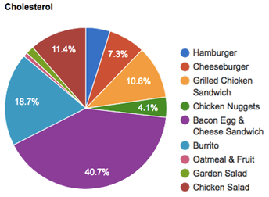
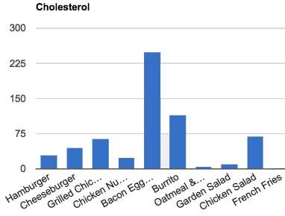
10,000 Foot View
What Questions Matter to You?
Introduction to Pyret
Writing functions
Writing queries
Bar and Pie Charts

Slide 14
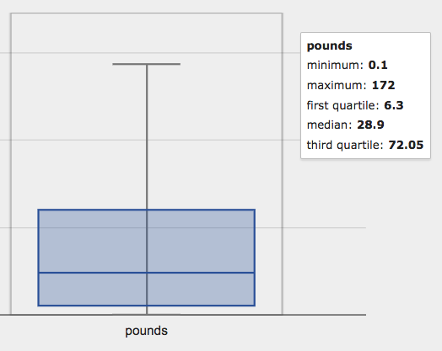
10,000 Foot View
What Questions Matter to You?
Introduction to Pyret
Writing functions
Writing queries
Bar and Pie Charts
Measures of Center/Variation

Slide 15
10,000 Foot View
What Questions Matter to You?
Introduction to Pyret
Writing functions
Writing queries
Bar and Pie Charts
Measures of Center/Variation
Histograms

Slide 16
10,000 Foot View
What Questions Matter to You?
Introduction to Pyret
Writing functions
Writing queries
Bar and Pie Charts
Measures of Center/Variation
Histograms
Scatterplots and Line-of-Best-Fit

Slide 17
10,000 Foot View
What Questions Matter to You?
Introduction to Pyret
Writing functions
Writing queries
Bar and Pie Charts
Measures of Center/Variation
Histograms
Scatterplots and Line-of-Best-Fit
Deepen analysis
Writing a research paper
?

Slide 18
Where Does DataScience Fit?
Data Science Classes
Math & Statistics Classes
Business Classes
Social Studies Classes
AP CS Principles Classes

Slide 19
Agenda
Introduction
Theory
Practice
Pedagogy

Slide 20
Setting up your classroom
Physical Materials (workbooks, pens, etc)
One computer for each pair of students
Gmail Account (per-class? per-pair?)
Log into http://code.pyret.org/
Go to www.BootstrapWorld.org/materials

Slide 21
Unit 1

Slide 22
Do Now
Find a topic that interests you
Choose a question, or create your own
Discuss your answer to the question (2min)
What measurements/data came up? (2min)

Slide 23
Introducing Pyret
Open the Shapes Starter File
About the Editor
Save a copy and click “Run”
Type shapes into the Interactions Area

Slide 24
Tables
Columns Row: Header v. Data rows
Add rows for circle, ellipse and rectangle
Columns: Categorical v. Quantitative
Quantitative values can be compared (Numbers)

Slide 25
Numbers and Strings
Complete Page 3
Numbers and Strings evaluate to themselves
Anything in matching quotes is a string
Operators need spaces around
More than one operator? Use parens!
Error messages are helpful!

Slide 26
Error Messages
How we react is key: are we scared or excited?
“The computer is giving you a clue…”
“What do you think it’s trying to tell us…?”

Slide 27
Booleans
Complete Page 4
The rules for parens and spaces still apply!
and & or
Add a new column called is-round
Is this column made up of qualitative of categorical data?

Slide 28
Functions in Pyret
Math: f(24), g(4, 17)
Pyret: f(23), g(4, 17)
triangle(50, “solid”, “red”)
When using a function, always write its name, then all its arguments (separated by commas).
What kind of mistakes could we make?

Slide 29
Back of your Book: Contracts!
Every function has a Contract
triangle :: (side::Num, mode::String, color::String) → Image
circle:: (radius::Num, mode::String, color::String) → Image
star :: (radius::Num, mode::String, color::String) → Image
Add a new column called example, and fill in the rows with images!
name
Domain (name :: Type)
Range

Slide 30
get-row
get-row :: (t :: Table, index :: Number) → Row
Index starts at zero, not one!
Use get-row to produce the 2nd and 3rd row of the table

Slide 31
Writing examples
example:
num-min(5, 19) is 5
num-min(5, -2) is -2
end
Example blocks are a way for us to automatically check our work.
Add two new examples that use num-sqrt
string-repeat :: (s :: String, n :: Number) → String
string-contains :: (search :: Str, for :: Str) → Boolean

Slide 32
Getting columns from a Row
Sometimes we want to get a single value out of a row
examples:
get-row(shapes, 0)[“name”] is “triangle”
get-row(shapes, 1)[“corners”] is 4
end
Add two more examples using row-accessors

Slide 33
Unit 2

Slide 34
The animals dataset
Open the Animals spreadsheet
Open the Animals Starter File, save a copy, & click “Run”
include gdrive-sheets
include tables
include image
# load the 'pets' sheet as a table called animals
animals-table = load-table: name, species, age, fixed, legs
source: pets-sheet.sheet-by-name("pets", true) end
Type animals-table into the Interactions Area
Complete Page 7

Slide 35
Defining Values
Math: x = 4
Pyret:
x = 4
name = “Nancy”
img = triangle(10, “solid”, “red”)
Define some values for different types!
mittens = get-row(animals-table, 3)
Define two new animals, using the appropriate names

Slide 36
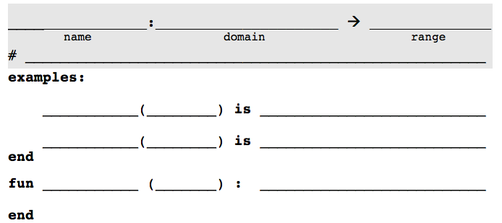
Defining Functions
Define a function called birth-year, which calculates the year an animal was born.
birth-year
birth-year
birth-year
animal
Number
(animal :: Row)
Consumes an animal, compute 2018-age to produce the birth-year
mittens
2018 – mittens[“age”]
birth-year
nori
2018 – nori[“age”]
2018 – animal[“age”]

Slide 37
Defining Functions
Pages 8-10: How many functions can you write?
Scaffold problem-solving
Multiple representations
Make thinking explicit
Pedagogical tool (battling, questioning, presenting)

Slide 38
Project: Choose Your Dataset!
Choose a dataset that interests you
We’ll be adding more
You can find your own (data.gov, google, and other sources)
You can collect your own using Google forms!
What question do you have about this dataset?
Open and Save a Copy of the Starter File
Complete Page 11.

Slide 39
Unit 3

Slide 40
Review and Introduction
Open the Animals w/Functions Starter File
Save a copy, click “Run”
Complete Page 15
Slicing and dicing data
What if the shelter wants a sorted list of animals?
Just cats?
Add a column for birth year?
Complete page 16

Slide 41
Methods
get-row(animals-table, 2)
animals-table.row-n(2)
Methods are called differently
Methods have different contracts:
<Table>.get-row :: (index :: Number) → Row
Methods have a secret argument
Complete page 17

Slide 42
More Table Methods
<Table>.order-by :: (col :: String, ascending :: Boolean)→Table
animals-table.order-by("species", true)
<Table>.filter :: (test :: (Row → Boolean) → Table
animals-table.filter(is-fixed)
<Table>.build-column:: (col :: Str, f:: (Row → Boolean) → Table
animals-table.build-column(“year”, birth-year)
Practice in the Interactions Area!

Slide 43
More Table Methods
Methods can be chained together:
animals-table.build-column(“year”, birth-year).filter(is-fixed).order-by("species", true)
animals-table
.build-column(“year”, birth-year)
.filter(is-fixed)
.order-by("species", true)
Practice in the Interactions Area!
Turn to Page 18…

Slide 44
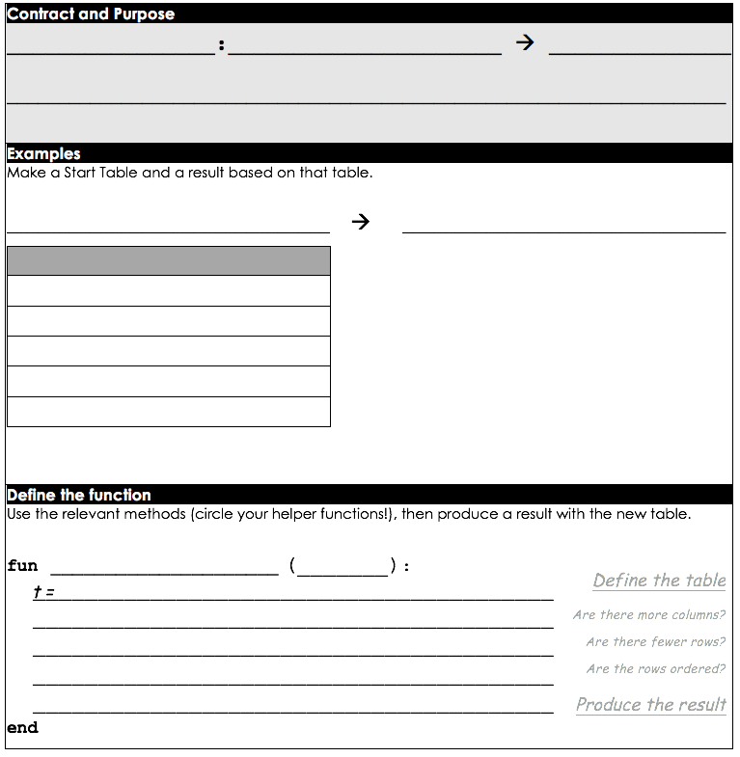
Table Plans
get-kittens-tags
get-kittens-tags
(animals :: Table)
Table
animals
produce a table of kittens, with nametags, sorted by age
animals-table
(animals-table)
get-kittens-tags
name | species | age | fixed | legs | weight | adopt
Sasha | cat | 1 | FALSE | 4 | 6.5 | 4
Toggle | dog | 3 | TRUE | 4 | 48 | 3
Buddy | lizard | 2 | FALSE | 4 | 0.3 | 12
Wade | cat | 1 | FALSE | 4 | 3.2 | 4
Mittens | cat | 2 | TRUE | 4 | 7.4 | 5
name | species | age | fixed | legs | weight | adopt | tag
Sasha | cat | 1 | FALSE | 4 | 6.5 | 4 | Sascha
Wade | cat | 1 | FALSE | 4 | 3.2 | 4 | Wade
Complete a Design Recipe…
animals
.filter(is-kitten)
.order-by(“age”)
t

Slide 45
Table Plan Practice
Complete pages 19-21
Scaffold problem-solving
Multiple representations
Make thinking explicit
Pedagogical tool (battling, questioning, presenting)
Top-Down Design

Slide 46
Project: Choose Your Dataset!
Complete Page 22.

Slide 47
Unit 4

Slide 48
Visualizing Quantity
Complete Page 25
Complete Page 26

Slide 49
Bar and Pie Charts
Open the Animals w/Functions Starter File
bar-chart :: (t :: Table, labels :: Str, values: Str) → Image
pie-chart :: (t :: Table, labels :: Str, values: Str) → Image
pie-chart(animals-table, "name", "age")
Interactive charts!
Turn to page 27, and write the Contract and Purpose
The result can be an Image! Draw a pie-chart for your sample table.

Slide 50
Making Good Sample Tables
Up to now, every Table Plan you’ve seen has included pre-written Sample tables. Why?
Now it’s time for you to start choose these tables yourself! A good sample table has several qualities:
Includes all relevant columns
Includes rows that will be filtered (both true and false)
Includes enough rows to show random ordering
Is properly representative of the entire dataset
The Austerity Problem
Complete Page 28, Practice on 29

Slide 51
Your dataset
Make a bar and a pie chart for two columns in your dataset
Feel free to use the blank Table Plans on Pages 29-31!
Write up your findings on Page 32

Slide 52
Unit 5

Slide 53
What do you think?
According to the Animal Shelter Bureau, the average pet waits 6 weeks to be adopted.
Does that mean most pets wait more than a month to find homes? Why or why not?
Open the Animals w/Functions Starter File
Summarizing columns (GPA, Credit Score, Pass Rates…)

Slide 54
Mean
The Mean is the Sum, divided by the Length of the list.
What is the mean of 5, 2, 3, 1, 4?
Pyret has a mean function for tables!
mean :: (t :: Table, col :: String) → Number
mean(animals-table, “weeks”)
Write your answer on Page 35

Slide 55
Median
The Median is the “middle” value of a sorted list of numbers
What is the mean of 5, 2, 3, 1, 4?
If there is no “middle”, take the mean of the “middle two”
What is the mean of 5, 2, 3, 1, 4, 6?
median :: (t :: Table, col :: String) → Number
median(animals-table, “weeks”)
Write your answer on Page 35

Slide 56
Modes
The Modes are the “most repeated” value in a list of numbers
What are the modes of 5, 2, 3, 3, 1, 4?
There can be more multiple modes: 5, 2, 3, 3, 1, 4, 6, 5
There can be no modes: 5, 2, 3, 1, 4, 6?
modes:: (t :: Table, col :: String) → List<Number>
modes(animals-table, “weeks”)
Write your answer on Page 35

Slide 57
Which measure is “best”?
Imagine that a math teacher is tracking their students’ grades. Here are the students’ grades on the first test.
grade-list = [list: 68, 64, 62, 100, 100, 68, 67]
Which measure gives the best indication of how the class did?
mean: 75.57
median: 68
mode: 69
Outliers

Slide 58
What do you think?
According to the US Census Bureau, the average American household earned more than $45,000 in 2003 - more than 3x the poverty line that year.
Does that mean only a small percentage of Americans were in poverty that year?

Slide 59
Variation Matters
Plotting values on a number line
The median defines two halves
The medians of the halves defines two quartiles
Interquartile Range
Range
Min
Q1
Median
Q3
Max

Slide 60
Variation Matters
Five-Number Summary
Min, Max, Median (Q2), Q1 and Q3
Write this on Page 35
All we need to make a box-plot!
box-plot:: (t :: Table, col :: String) → Image
box-plot(animals-table, “weeks”)
Sketch this on Page 35

Slide 61
Page 36
variation-dog-age
(animals :: Table)
Number
variation-dog-age
animals
Produce a box-plot of the ages for dogs in the animals table
animals-table
(animals-table)
variation-dog-age
name | species | age | fixed | legs | weight | adopt
Snowcone | cat | 2 | TRUE | 4 | 6.1 | 5
Lucky | dog | 3 | TRUE | 3 | 45.4 | 9
Hercules | cat | 3 | FALSE | 4 | 13.4 | 7
Toggle | dog | 3 | TRUE | 4 | 48 | 3
Snuggles | tarantula | 2 | FALSE | 8 | 0.1 | 1
3
Complete a Design Recipe…
animals
.filter(is-dog)
box-plot(t, “age”)

Slide 62
Your dataset
For practice, complete Page 37
Explore Center and Variation for your data on Page 38
How else can we visualize variation…?

Slide 63
Unit 6

Slide 64
Visualizing Frequency
Complete Page 42
What are the two charts measuring?
These charts visualize the frequency with which certain values appear in our dataset!
freq-bar-chart :: (t :: Table, labels :: Str, values :: Str) → Image
histogram :: (t:: Table, labels:: Str, values:: Str, bin-width:: Num)→Img
Notes:
By filling in the last bar, you have created a bar chart. However, there’s something special about chart. What is different about this bar chart from the ones we have created before?
Previous bar charts used a column from the table as the labels, and another column as the values.
In this bar chart, we are using the categories of a column as the labels, and the frequency of each category as the value.
Here, we are looking at the Eye Color column, which contains categorical data. In this special kind of bar chart, we are computing the frequency of each category, and that frequency relates to the length of each bar. Since there are 3 people with brown eyes, the bar for Brown extends to 3 marks long.

Slide 65
Bins and Spread
What does the last argument to histogram mean?
What if there were only 2 bins? 40?
Complete Pages 43 and 44…
Explore variation in your dataset, and write up your findings on Page 45
Notes:
Unfortunately, we still don't know if 7 comes up often enough for this to be a game worth playing! We've used our measures of center to figure out the most frequent number, but just @italic{how frequent is it}? We need some way of asking if 7 appears more than all the other numbers combined.

Slide 66
Which Chart is Best?
You’ve seen
Bar Charts
Pie Charts
Frequency Bar Charts
Histograms
How do you know which one to use?
Complete page 46
Notes:
Unfortunately, we still don't know if 7 comes up often enough for this to be a game worth playing! We've used our measures of center to figure out the most frequent number, but just @italic{how frequent is it}? We need some way of asking if 7 appears more than all the other numbers combined.

Slide 67
Unit 7

Slide 68
Do Now
“Young animals are cuter,
and therefore get
adopted faster”
Do you agree?
- Write your hypothesis on Page 49

Slide 69
Scatter plots
Complete Page 50.
Scatter plots visualize relationships between two columns
scatter-plot :: (t :: Table, xs:: Str, ys:: Str) → Image
labeled-scatter-plot :: (t :: Table, labels:: Str, xs:: Str, ys:: Str) → Img
Make a labeled-scatter-plot for age v. weeks, using names as the labels
Complete Page 51
Notes:
By filling in the last bar, you have created a bar chart. However, there’s something special about chart. What is different about this bar chart from the ones we have created before?
Previous bar charts used a column from the table as the labels, and another column as the values.
In this bar chart, we are using the categories of a column as the labels, and the frequency of each category as the value.
Here, we are looking at the Eye Color column, which contains categorical data. In this special kind of bar chart, we are computing the frequency of each category, and that frequency relates to the length of each bar. Since there are 3 people with brown eyes, the bar for Brown extends to 3 marks long.

Slide 70
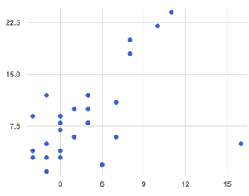
Searching for Correlations
Age (yrs) v. Adoptions (wks)
Is there a trend?
Are there outliers?
Hover over each dot.
Correlations
Direction
Strength

Slide 71
Correlation <> Causation
Search for correlations – not causes! – in your dataset

Slide 72
Predictors
Age (yrs) v. Adoptions (wks)
Suppose there is a trend
Can you draw it?
We can make predictions!
Page 52…

Slide 73
Your Dataset
Generate some scatterplots from your data
What patterns emerge?
Are they strong or week?
Positive or Negative?
Write up your findings on Page 53.

Slide 74
Unit 8

Slide 75
Searching for Correlations
How do we measure the “fit” of a predictor (strength of correlation)?
How do we draw the predictor with the “best fit”?
Complete Page 57
Playing with predictors
Age (yrs) v. Adoptions (wks)

Slide 76
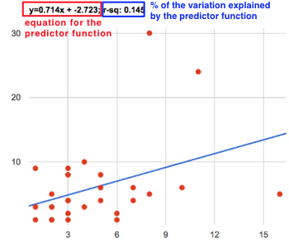
Linear Regression
lr-plot :: (t :: Table, xs:: Str, ys:: Str) → Image
labeled-lr-plot::(t :: Table, labels:: Str, xs:: Str, ys:: Str)→Img

Slide 77
Linear Regression
r²
slope
y-intercept

Slide 78
Practice Making Scatterplots
The age vs. weeks waiting for adoption, but just for the dogs in the shelter.
The weight vs. weeks waiting for adoption, but just for the cats in the shelter.
The age vs. weight waiting for adoption, but just for animals that have been fixed.
Write up your findings on Page 58

Slide 79
Your Dataset
Write up your findings on Page 58

Slide 80
Unit 9

Slide 81
Fake News!
People misrepresent data all the time
Turn to Page 61
Being able to speak accurately about data is an essential part of being a Data Scientist
Your Research Paper

Slide 82

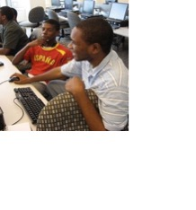
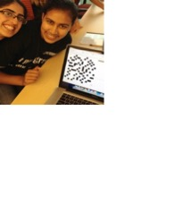
Algebra
Bootstrap:Algebra applies algebraic
concepts and rigorous programming
principles to creating a simple
videogame. Students use order of
operations, function composition, the
distance formula, coordinates and inequalities in the plane to detect collisions, handle keystrokes, and determine how they move and interact – with each challenge framed as a standard word-problem. The module is aligned to National & State Standards for Mathematics, the CSTA standards and K12CS frameworks, and has been shown to improve students’ performance on standards algebraic tasks*.
DataScience
Which artist do you listen to most? Do
schools in richer areas of your town do
better than those in poorer ones? What’s
the healthiest cuisine? Our Data Science
module teaches students to view
programs as questions we ask of data. Students form their own questions about the world around them, and learn to analyze data critically and carefully to find answers. Business, science, and history teachers can utilize this module to help students make inferences from data. Math teachers can use this module to introduce statistics in an accessible way. It also works great as a module for AP CS Principles’ unit on data!
Physics
This module is developed in partnership
with the American Association of Physics
Teachers & American Modeling Teachers
Association. It helps students understand
dynamics concepts by using
programming to build models of the
physical world. The module is targeted at ninth grade, a year in which every student is expected to take science. The module is aligned to the Physics First movement, allowing teachers to present computational modeling as a basic tool to students preparing to study science more broadly.
Reactive
Bootstrap:Reactive goes deeper into
programming, building events and data
structures on top of the foundation laid by
our intro courses and allowing students to
build far more sophisticated programs.
Students learn how the event loop that drives their Bootstrap:Algebra game works, and use it to create animations using simple datatypes. They then learn about data structures, and design a structure for a sophisticated game of their own design. Bootstrap:Reactive is aligned to the CSTA standards and K12CS frameworks.
Notes:
This is just one part of a multi-facet pathway that we at Bootstrap have created. Bootstrap:Physics allows your physics teacher to integrate computing into a standard HS Physics class, and Bootstrap:Reactive allows your students to go deeper into CS by building on – rather than throwing away – what they’ve learned. But there’s also a new trend in CS, which is taking over universities and the corporate world: Data Science. Here are just a few screenshots of major institutions that are pushing for Data Science. And now…Bootstrap is offering an introductory Data Science module for middle or high school, which requires no computing background!

Slide 83


Connect with Us!
/ BootstrapWorld
@BootstrapWorld
Questions:
bit.ly/BootstrapHelp
Grab a photo!

Slide 84

Notes:
Use this slide as background for the Group Photo

Slide 85
We’d like your feedback!

